Slide 1

Understanding your electricity bill
David Neyle
Volunteer Community Energy Coordinator

Slide 2
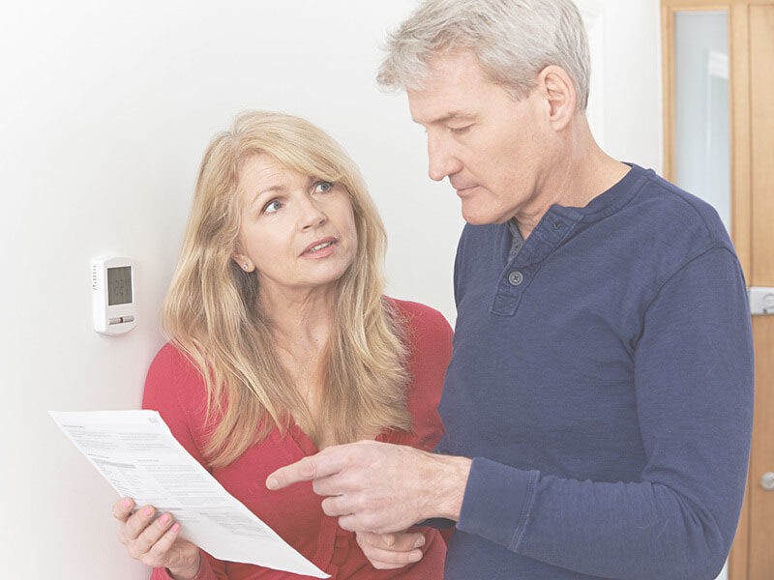
Reading your electricity bill
It can appear quite confusing!
Important to understand what you are paying for so you can manage it

Slide 3
Objectives for today
Explain the difference between ‘power’ and ‘energy’
Identify big energy using appliances in the home
Locate your NMI number
Identify the different tariffs and tariff pricing on your electricity bill
Analyse the total cost of your electricity bill and compare to community averages
Assess and consider practical actions you could take to reduce your electricity bill

Slide 4

“Power” and “Energy”

Slide 5
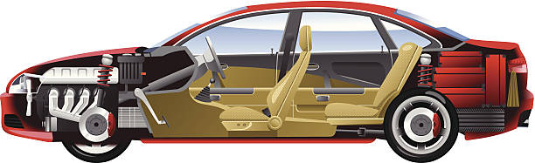
“Power” and “Energy”

Slide 6
“Power”
Power is the instantaneous amount of electricity being used
Measured in ‘Watts’ (W) [a thousand Watts is a kilowatt, kW]
Electrical appliances are rated in Watts or kilo Watts (kW) – the bigger the number the more power required to make them work.

Slide 7
“Energy”
Energy is Power x Time
Electrical energy is measured in watt.hours (Wh)
A thousand watts of electric power used over an hour is 1 kilowatt.hour (kWh)

Slide 8
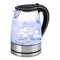
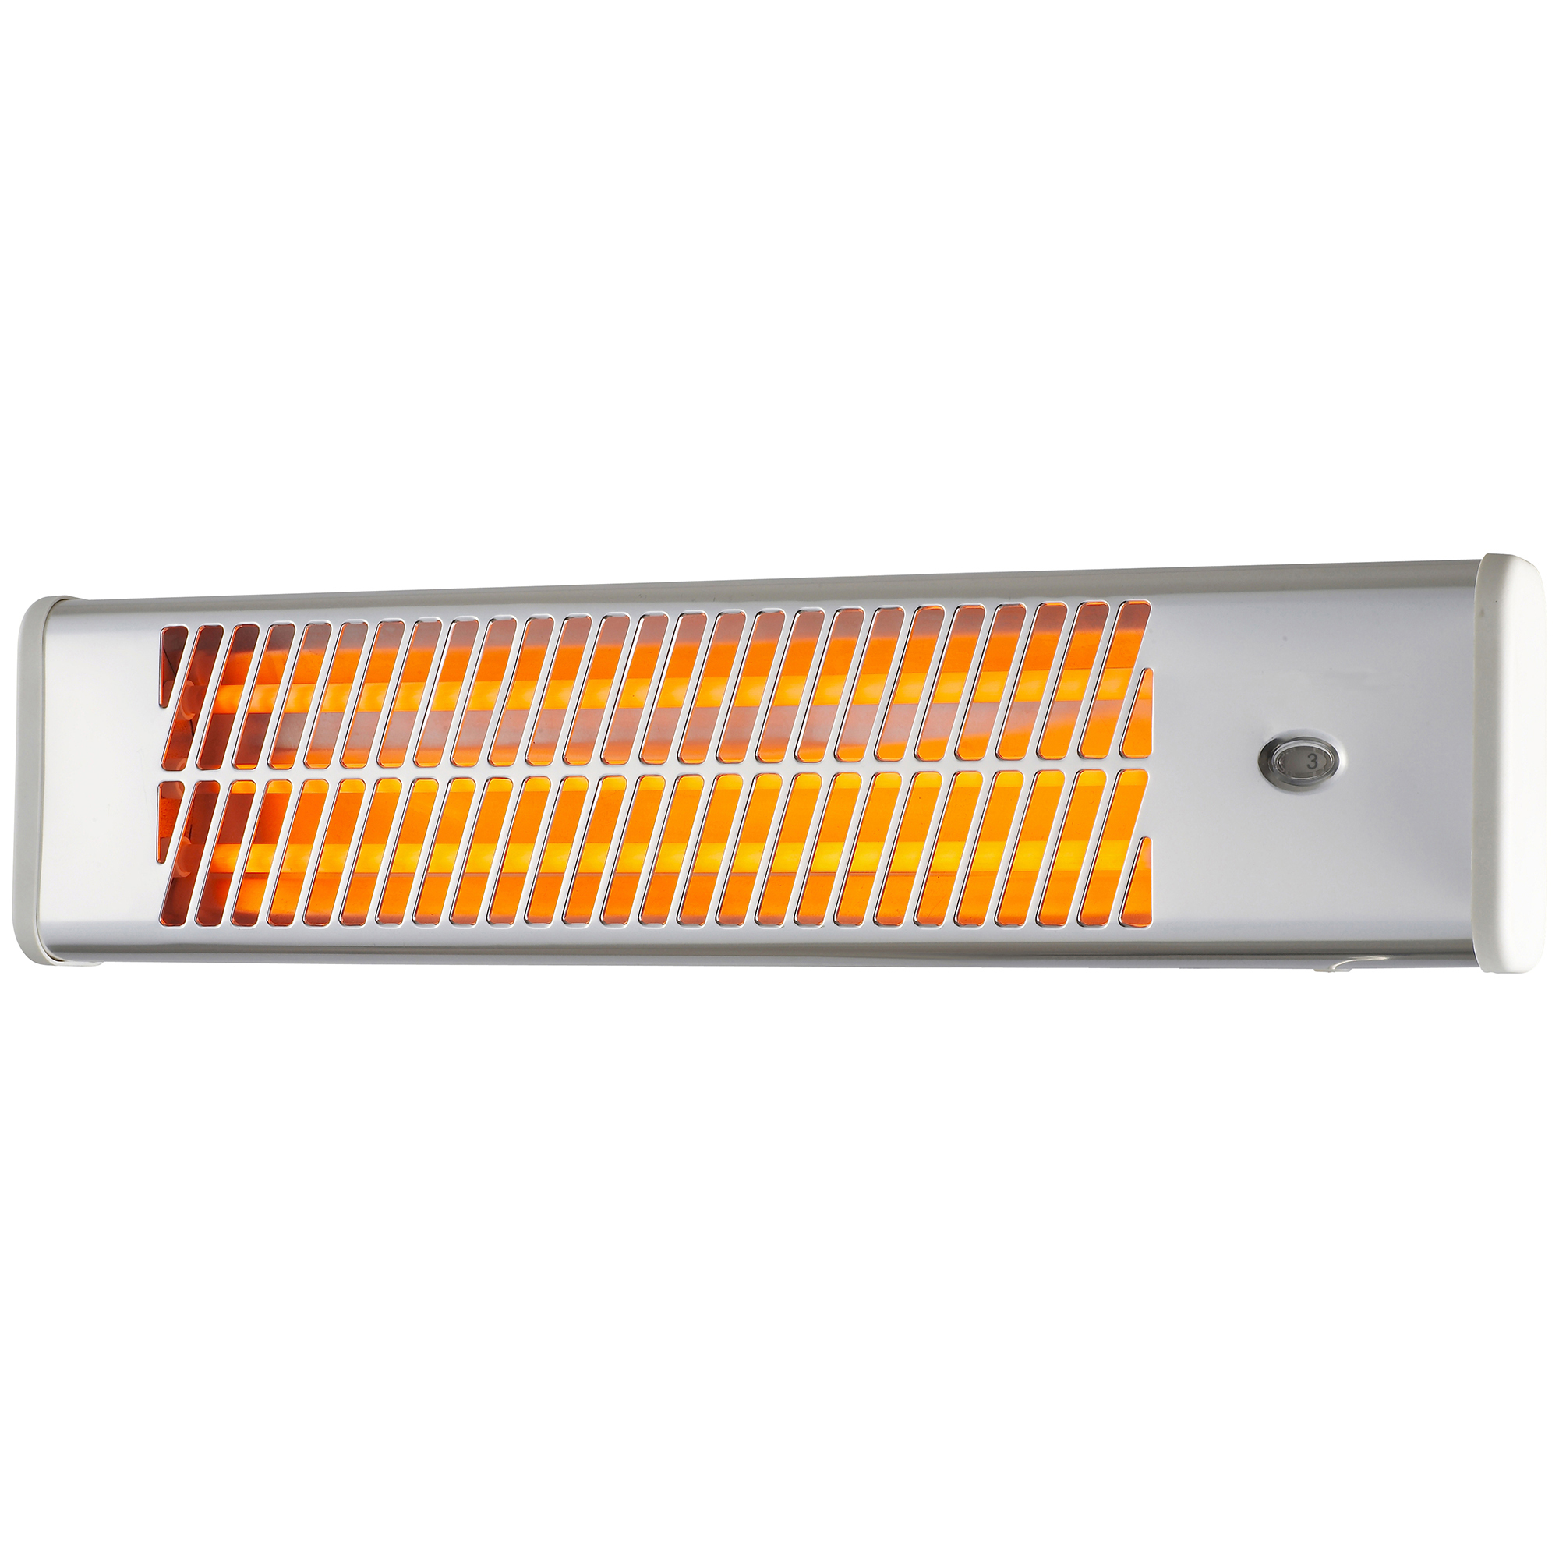
“Energy”
Two appliances with the same power rating – 2kW
Electric kettle, 2kW, takes a minute to boil
2kW x 40c/kWh x 1/60 = 1.3 cents
Bar radiator, 2000W (2kW) used for 2 hours = 4kWh
2kW x 40c/kWh x 2 hours, therefore $1.60 to run for 2 hours

Slide 9
“Electrical Energy”
The amount of electricity (energy) you use and get charged $$ for =
Rating of the appliance
How long it is consuming electricity
Shows on your bill as kWh

Slide 10
Big electricity energy appliances

Slide 11
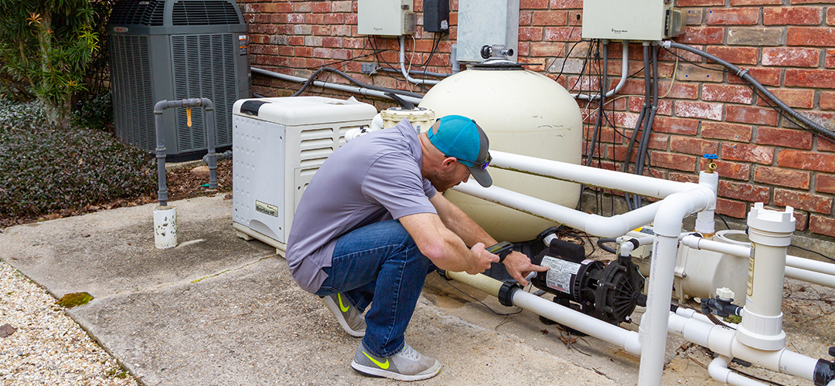
Big electricity energy appliances
Pool pump
2.4kW x 3 hours = 7.2kWh

Slide 12
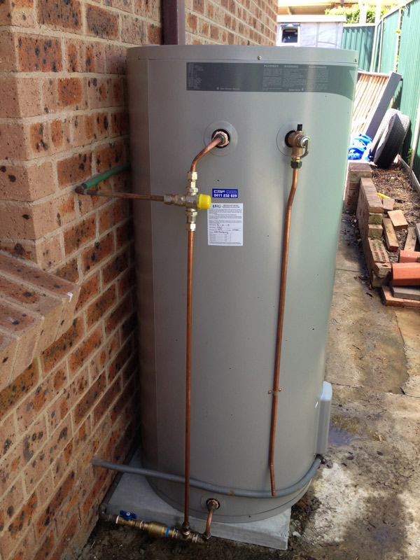
Big electricity energy appliances
Resistive Element Hot Water Service
3kW x 4 hours = 12kWh

Slide 13
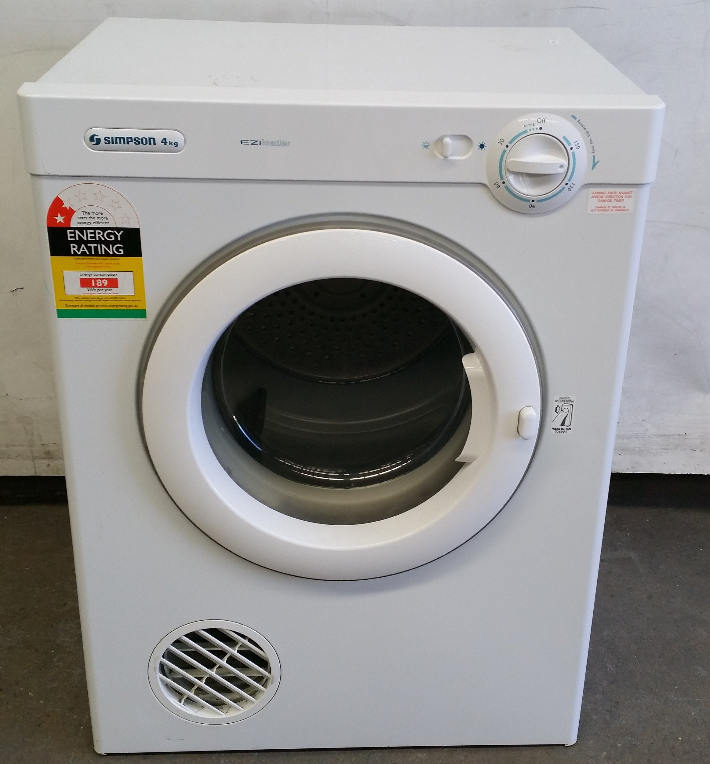
Big electricity energy appliances
Heating-element Clothes Dryer
2.4kW x 2 hours = 4.8kWh
~ $1.92

Slide 14
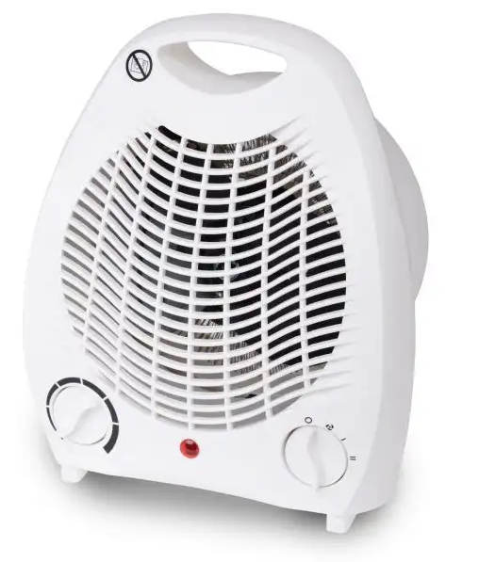
Big electricity energy appliances
Fan Heater ($19)
2kW x 6 hours = 12kWh
In three rooms?
12kWh x 3 = 36kWh = $14.40
Over 90 days = $1,296

Slide 15
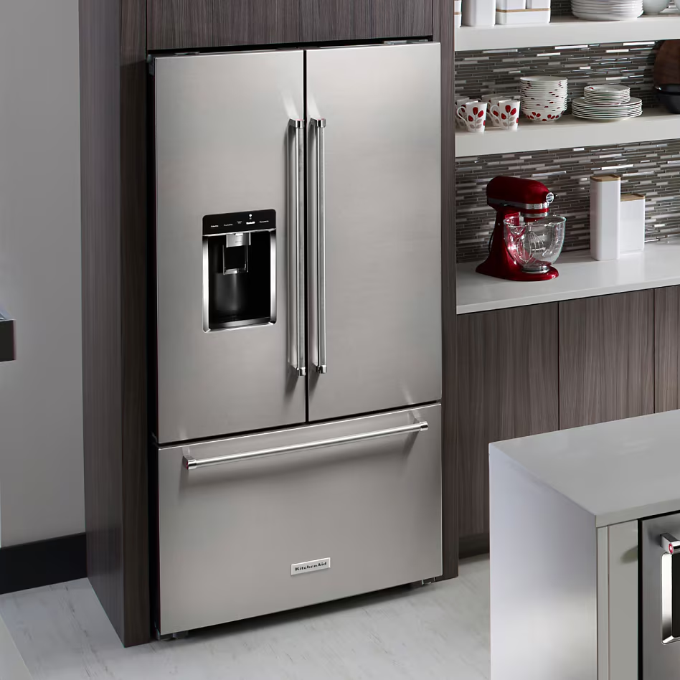
Big electricity energy appliances
Modern refrigerator
About 1kWh – 2kWh per day

Slide 16
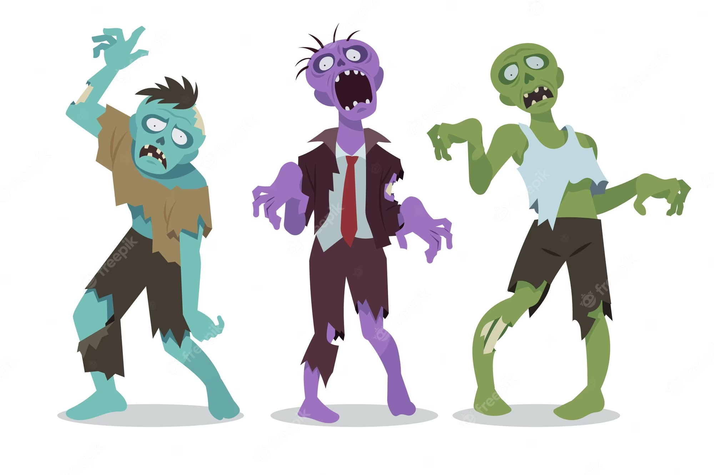
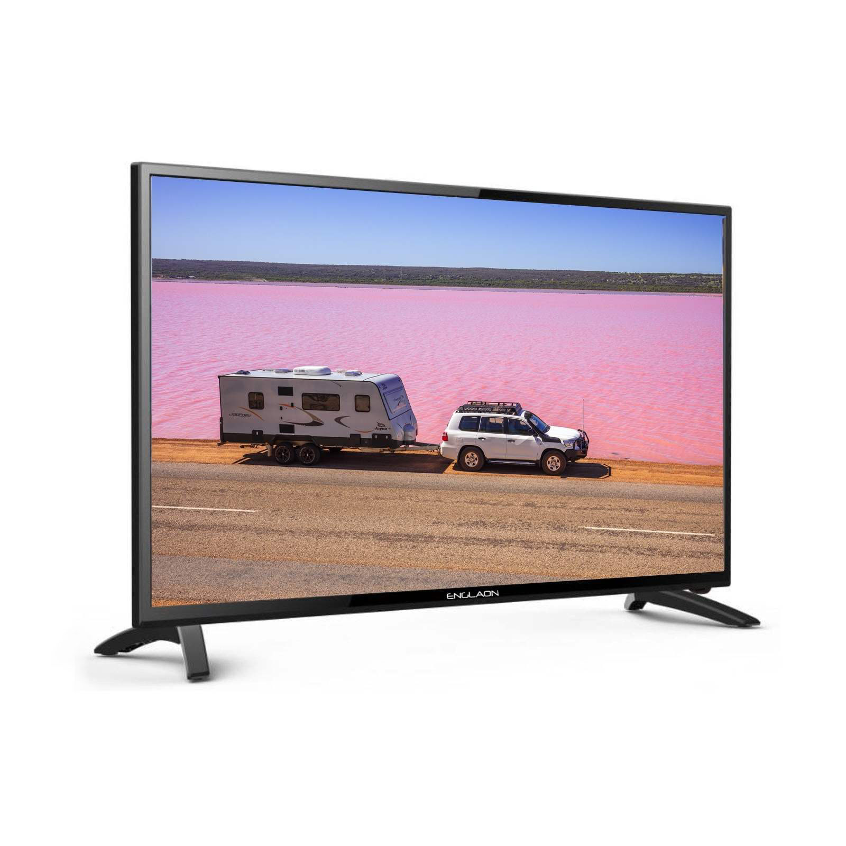
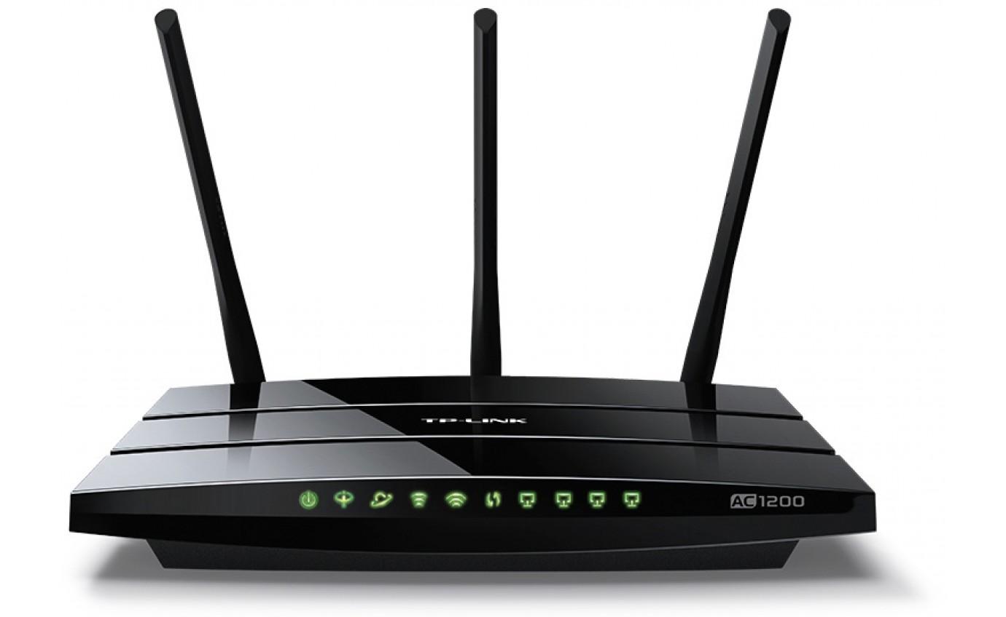
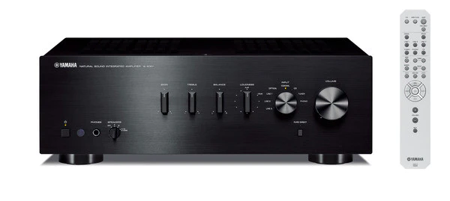
‘Zombie’ appliances
Appliances that continue to draw electricity when powered down (STANDBY MODE)
Very small overall impact on your bill
Notes:
‘Standby’ power consumption. Not the problem it was in the past. New appliances must have minimal standby energy consumption. Probably more dangerous and difficult trying to get down to the power point to turn them on and off.

Slide 17
Supply charge
Fixed amount, regardless of how much electricity you use
Pays for “poles and wires” – electricity distribution and administration costs
Currently about $2.00/day
$2.00 x 365 = ~ $720 year
If you have ‘off-peak’ hot water (controlled load), then about 20c/day is included in your supply charge. If you don’t have OPHW then your supply charge will be about 20c/day cheaper
Can’t be avoided unless you disconnect from the electricity grid.

Slide 18
Tariffs
What you pay per kWh – usage
There are a range of tariffs that you may or may not be using.
Fixed tariff – most common
~ 40c/kWh
Applies all day (24h /7 days week)
Controlled Load
~ 20c/kWh (OP hot water)
Supply is disconnected during peak periods
You are given the discounted tariff to compensate for not having electricity available during peak periods
These types of tariffs have been around for many years and are what people are most accustomed to seeing on their bill.

Slide 19
Tariffs
Time of use tariffs
A more recent innovation to encourage users to manage their use of electricity to assist the generators and distributors to manage the network.
Introduces three new tariffs:
Peak ~ 45c / kWh
Shoulder ~ 40c / kWh
Off-peak (different to OP hot water tariff) ~ 30c / kWh
Could be advantageous if you really focus on managing when you use electricity
Most people are being transferred to these plans, which might end up costing you more!

Slide 20
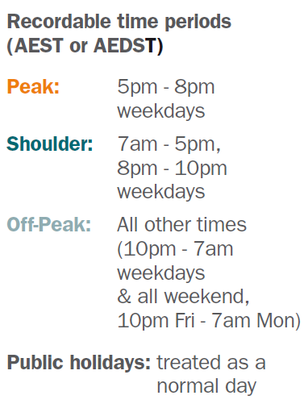
Time of Use – Essential Energy

Slide 21
Feed-In Tariff
What you are paid for selling your generated electricity back to the retailer
Usually, excess solar electricity
Very low = ~5c kWh
5kW x 8 hours x $0.05 = $2/day (at best!)

Slide 22
National Meter Identifier (NMI)

Slide 23
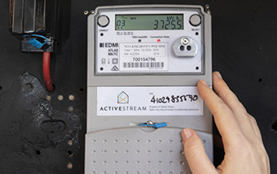
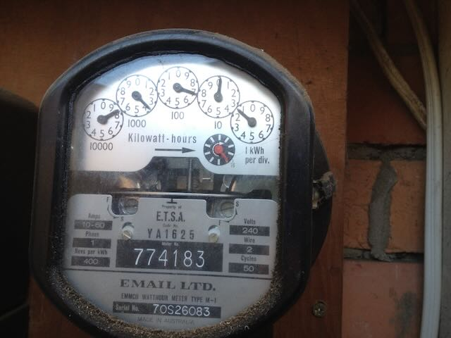
What is the meter/register reading?
Smart Meter
Analogue Meter

Slide 24

Meters in your Meterboard
They ‘register’ your electricity usage and network feed-in
Smart meters are able to be read remotely
Old analogue meters require a meter reader
You may get an ‘estimate’ read
Smart meters may have more than one register, especially if you have 3-phase power to the property
Shows on your bill as a meter or register reading
‘start’ and ‘finish’ number for the period of the bill

Slide 25
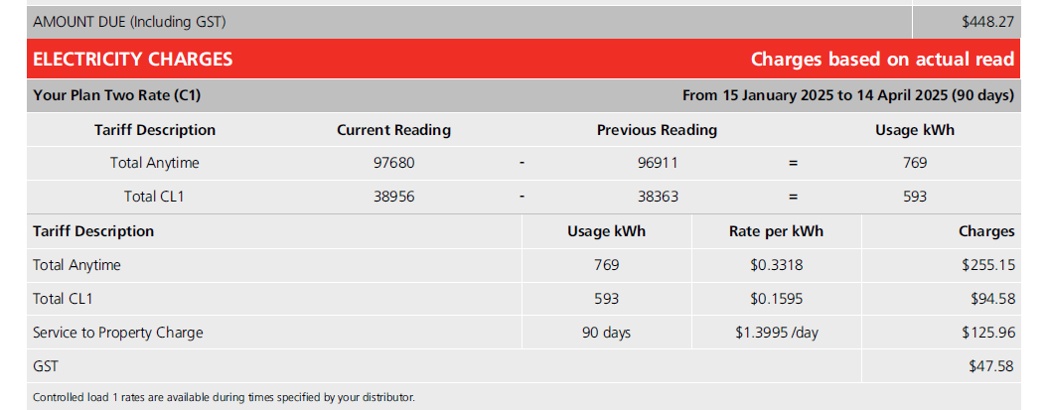

Slide 26
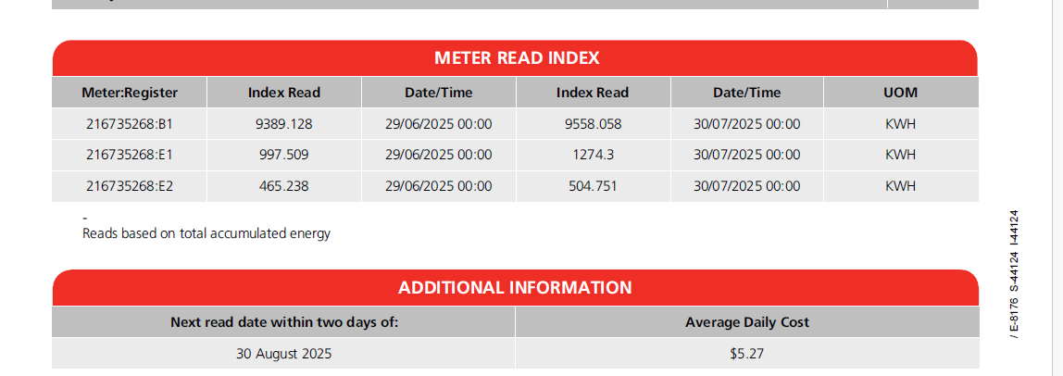
‘B’ register = solar feed in
‘E1’ register = General use
‘E2’ register = Controlled load

Slide 27
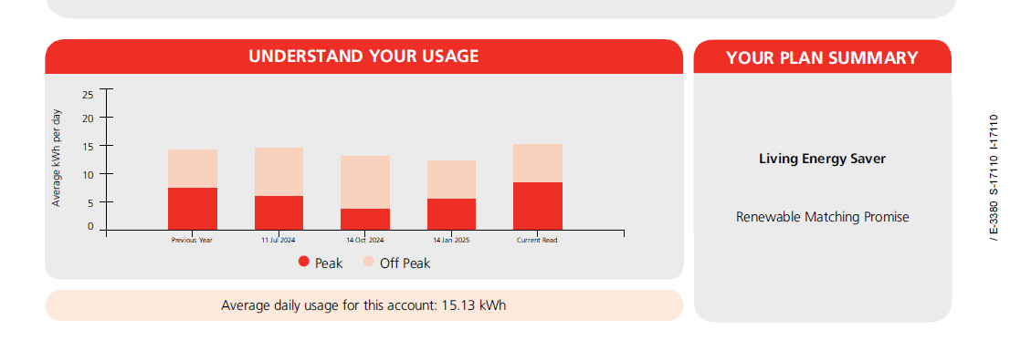
Analyse your bill
How much electricity am I using compared to an average user?
Average house 15kWh ↔ 20kWh per day

Slide 28
Group Exercise
Find your NMI number on your bill
Your contract: Fixed rate tariff or Time-of-use tariff?
What is your daily supply rate cost?
What are the various tariff rates you are paying?
How many days/period is your bill for?
Based on your daily usage, does it seem about right or not?
Given what you have learnt about energy consumption and tariff rates, in order to reduce your bill, what is one thing you could consider doing?

Slide 29
Don’t pay the ‘lazy tax’
Shop around regularly!
Ask for a better deal (they keep them under the counter!)
https://www.energymadeeasy.gov.au/

